Slide 1
More CNN concepts
OG

Slide 2
Image transformations, kernels
Kernel is the basic building block of filters or CNN!
Blurring is averaging the values with its neighbours (0-255) RGB
If you have 9 pixels(9 values) ( can be direct or diagonal neighbours)
Sharpening highlight the difference in pixel values (opposite)
Find the differences between neighbor pixels and double it.
Subtract direct(non diagonal) neighbours and subtract them from the center pixel.
Edge detection multiply neighbours by -1 and multiply center pixel by 5
This means highlight the edges or sharpen the edges

Slide 3
Kernels ( again yes)
Once again, kernels are the matrices that describe how a certain transformation is to be applied to an image
Computationally efficient, visually understandable
CNN and KERNELS
You apply cnn when you have a data with certain structure. In this case, you need a way to transform the data without losing the structure( for example, an image)
2.1

Slide 4
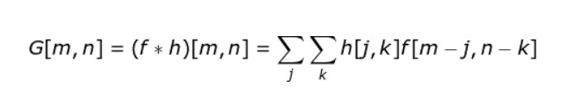
The operation of sliding the kernel OVER an image and calculating the value for every position is called convolution ( I hope you feel better now)
Roughly lets say this: A neural network using kernel can be called: convolutional neural network ( good luck with this formula of convolution)
G(m,n) is the resulting pixel m n
f is the original image, h is the kernel or filter
Actual convolution is here with DOUBLE SUM
Convolution flips the kernel around(rotate) (non flipped kernel means cross correlation in mathematics.

Slide 5
But how do we apply KERNEL to edges
You need neighbor pixels to apply,
one solution can be ZERO PADDING. Extend the image outwards and add zeros
Another solution, extend the image( place an image to an image and extend the pixels)
Another solution, omit all the pixels in the edge! If the image is bigger than 256, this approach is OK

Slide 6
Detect means: To emphasize the differences between various features in an image. How do we classify a dog and a cat picture?
You can think of being a math guy and try to build your own kernel.
OK but what if when there are different cat and dog breeds?
Your option is let computer learn so you don’t need to worry about
You might hear kernels are referred as filters.
In order to produce the transformed image, You CONVOLVE the original image and the kernel (these layers are called as convolutional layers
Do not rely on only Feed Forward NN. ( when you have colors)
When you take all pixel values and order them lines of numbers you lose spatial information (you destroyed the structure of the image)

Slide 7
Good news, you keep the structure and use CNNs. HOW?
We pass the image to an 2D matrix
More good news, now you reduce parameters your network needs to optimize!!
Example: if you have fully connected layer and reduce the dimensionality 1600x1200 to 800x600.
Congratulations(NO) you need 920 BILLIONS of weights for your model for only ONE single layer
CNN with a kernel 5x5 require only 25+1 weights (1 is bias)
If you are tired of this, usually couple of CNN layers will be enough initially

Slide 8
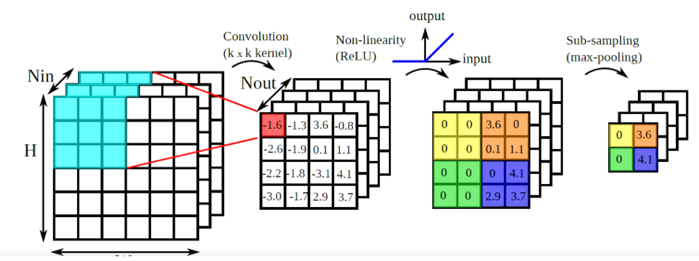
Check the blue area, and note(multiply by kernel) the are with a number ( red) ( you don’t lose information) Then you slide the kernel and repeat. ( you can also skip and apply once every 2 pixels!)

Slide 9
Edge pixels are always problem, it is ok to be not tryhard and ignore the edge pixels
In the end you have a new matrix (smaller) (this will not an image but features) I will open MNIST data and show you some digits, lets try to recognize without seeing the full digit!
The resulting matrix is called FEATURE MAP
We always slide the kernel, that’s why CNN is smart ( if you apply DNN images must be static, if you move the image even by few pixels you will destroy the results)
Basically CNN layer is where YOU SEARCH FOR A PATTERN
i.e edges, curves, angles etc
Now think of having not one but 100s of kernels to detect features!
In reality you deal with color images(RGB) meaning you have 3 matrices

Slide 10
Pooling layers
Pooling is reducing the dimensionality of the problem (speed the algorithm) Scientists chose this name `pooling` not shrinking just to be cool
Pooling is useful against overfitting (I show you types of pooling in the other presentation)
NN can know the rough area of an object in the image( if you have a cloud in an image you don’t need full coordinates)
Apply pooling after Convolution layer
Pooling makes noise, therefore it is harder for the network to learn this noise thus it is harder to overfit

Slide 11
OMG what H$!* is striding
Stride: How much Kernel moves at each step
Check github link in other presentation
Stride can be any number!
Usually start with stride number equals to kernel side
For example: have 2x2 max pooling with stride 2
Observe the link for visualization
Hint: Start with square kernel initially
Kernel size: choose odd number ( to have one pixel to focus in the middle!!!!) (example:3x3)

Slide 12
DIMENSIONS
If you have a color image of 32x32 your input is 32x32x3
As an example use Convolutional layer by 10x5x5x3
Above means with 10 kernels:
(32x32x3) * (10x5x5x3) =
We ignore the edges that’s why we have four sides truncated (so 28)
28x28 (feature map) but we have 10 kernels: 10 feature maps
Output is: 28x28x10
Lets apply max pooling now
(28x28x10) /2 = (14x14x10)

Slide 13
Input -> Convolution1 -> Max pool -> Convolution2(another)
32x32x3 -> 28x28x10 -> 14x14x10 -> 12x12x6
Above 12x12x6 because: 14x14x10 -> 6x (3x3x10) -> 12x12x6
Good news: you don’t care about this calculation when you use high level libraries

Slide 14
A Revision of Activation functions
We want nonlinear behavior by stacking layers on top of each other
In this way this architechture is stronger than just summing.
SAY GOODBYE TO LINEAR REGRESSION IN Deep NNs we have nonlinearity
Non-linearity + layer
Linear Layer + Linear Layer + Linear Layer -> Linear (boring)

Slide 15
I hope you remember RELU, it’s the most common activation functions, we use it or we use its derivations
RELU: its output is simply the input ( if the input is greater than zero)
Otherwise it returns zero ( check NN. Materials for my explanation)
Softmax is used for dealing classification.
Softmax is to transform arbitrary large or small numbers that come out of previous layers and fit them into valid probability distribution
(multi class classificaition) ( always use at the final layer)
Sigmoid is sigmoid, binary classification

Slide 16
Early stopping
Don’t fit the data perfectly (when it captures noise but not general idea)
Train using training set, test using test data. ( I hope you remember)
How about we stop the training before the predetermined completion to avoid validation loss-training loss gap(overfit)
This is early stopping.

Slide 17
Optimizers
Prepare yourself for the best definition of ML
Machine learning is a process that the computer gradually learns what parameters or weights fit the training data best. (I should have put a picture of happy robot here)
Optimizers are your bread and butter in this case
Minimize the loss function ( how well/bad its doing)
i.e: gradient descent ( size of the step is learning rate

Slide 18
Optimizers cont.
When gradient descent stucks in local minimum, you cry
Or you can use a method which is momentum basically how fast you are going to downhill so you can skip local minimums
AdaGrad and RMSProp combined and here is:
ADAM
Adaptive moment estimation( use it initially )

Slide 19
About MNIST
You have 28x28 input , start with 3x3 and experiment!
Do not ever try to generalize how to select parameters ( this is not a mathematics course) ( for each dataset and each CNN you will have different parameters! )
Use ReLU for CONV layer ( behaves normal mostly)
Number of Kernels: again. Arbitrarely chose!

Slide 20
28x28x1 –> Conv, 5x5, 50 ,Relu
–> 24x24x50 –> MAX PooL 2x2, stride 2
–>12x12x50 –> Conv, 5x5, 50 ,Relu
–> MAX PooL 2x2, stride 2
–> 5x5x50 (1250 flatten layer) –> Dense Layer (softmax act. function)
Green and blue layers help us to find multiple feature maps!
Dense layer is a transformation, in which every output is the result of linear combination of the inputs! (fully connected layer)
Dense layer represents the probabilities of each digit ( that’s why softmax)

Slide 21
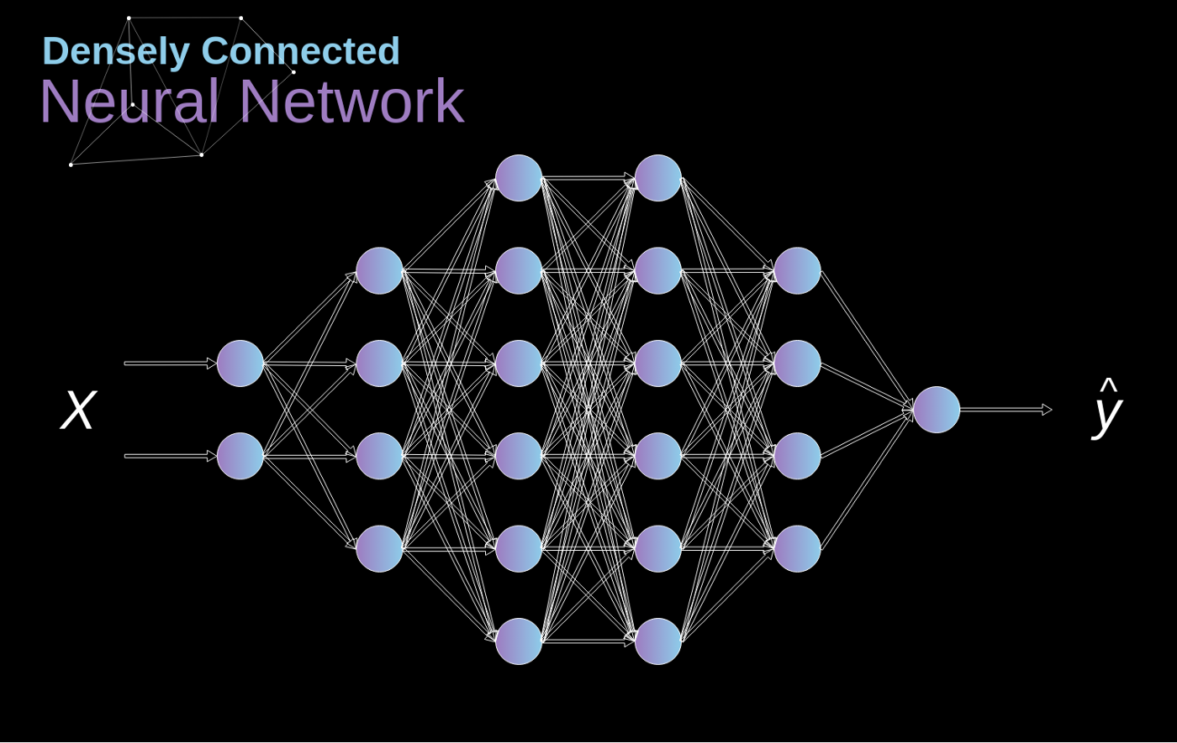
It’s a usual Dense neural network

Slide 22
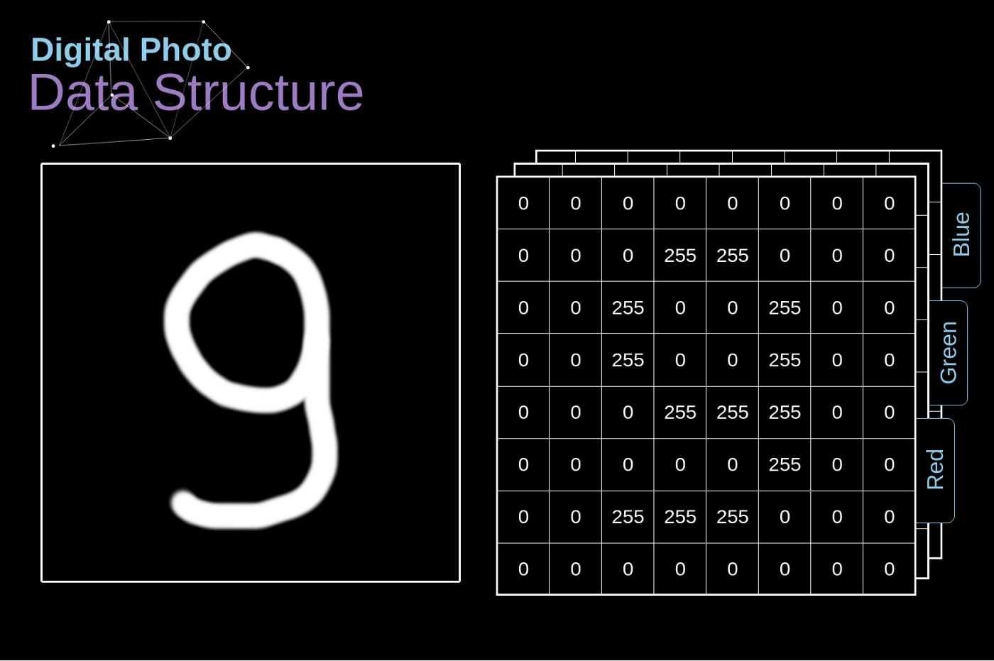
Computers can smile using numbers

Slide 24
Remember the edge detection in the very beginning

Slide 26
DNNs are bad at working with images, because of number of parameters. But look now:

Slide 27
Back propagation here

Slide 28
MAX POOLING

Slide 29
Regularization
It is not possible to predict the patience parameter using Early stopping ( can cause NN to stop earlier than needed)
You can decrease the capacity of the network by just decreasing the complexity of the model
Regularization reduces the models capacity to learn!
We add factors to the loss function that changes the behavior of the training process.
Lnew = Lold + RegularizationFactor
This is where we punish the network when loss is increased so model do not trigger that event. On the contrary we can decrease the loss, model will be encouraged to follow that pattern.

Slide 30
We want to prevent(inhibit) the capacity of the NN with numbers that can be added to the loss function
If model is simple, many parameters(weights) will be zero or close to zero
If the model is complex this will be opposite. (complexity is related to your values of the weights.)
Exact combination of these values determines the type of the regularization.

Slide 31
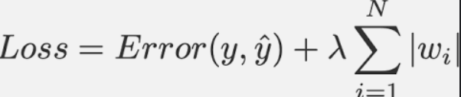
L2 Regularization and Weight Decay
Sum sign represents how complex is the model and Lambda is to tune the model. (Lambda of ZERO means complete disregard of L2 while a big value mean that regularization factor outweights the actual loss and RENDERING THE TRAINING USELESS
The purpose of the L2 is to simplify the model by scaling down all non essential weights.
Weight decay has constant effect in SGD, while using Adaptive learning it is different in the beginning and different in the end of training.
When you have SGD (learning rate is constant), two techniques are same, but not for ADAM
L1 regularization penalizes the sum of absolute values of the weights, whereas L2 regularization penalizes the sum of squares of the weights

Slide 32
Dropout
Dropout can be used for same purpose (against overfit) but it’s a different technique.
Randomly choose neurons and drop them (zero) in each epoch
We are making neurons independent from each other, therefore they can learn whole data. (0.1 means 10%)
Its applicaple to all types of NNs ( popular choice using Dense Layers)

Slide 33
Data Augmentation
We will be focusing on dataset not the Network
If an image is slightly moved to the side, for DNN it will be almost impossible to learn.
As an example if all the photos of the cats are facing to the right, CNN will learn in the same way ( not good) To overcome this problem we use data augmentation ( change, resize, zoom-in, zoom-out, upside-down, mirroring, flip vertical or horizontal)
Therefore model will be less biased.
We are expanding the capability of our CNN not trying to increase the accuracy.

Slide 34
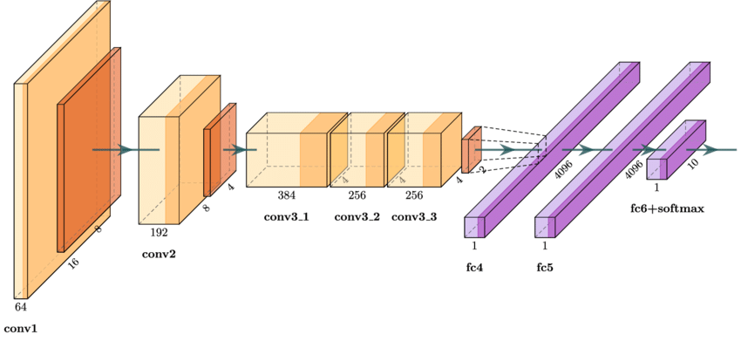
AlexNet (boring view)

Slide 35
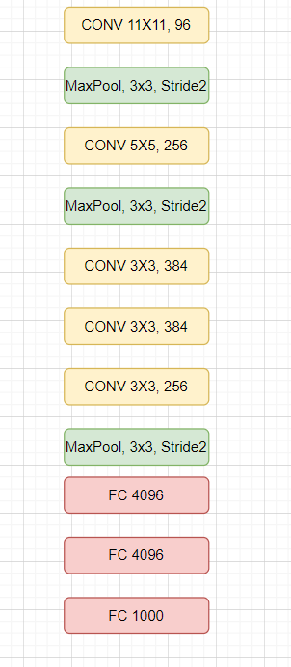
Perhaps you don’t like that image in previous sectionI took from Google, here something better: Don’t be shy and do your own Alexnet model later. Just like we did in our course)) Alexnet uses ReLu and Softmax(in the end) activation function Alexnet uses Dropout, SGD+Momentum and Data Augmentation

Slide 36
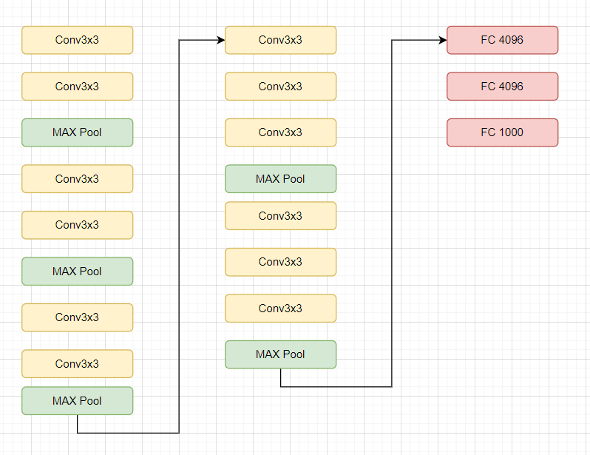
VGG In each vgg layer we have 3x3=9 weights while in Alexnet for 11x11 it was 121.

Slide 37
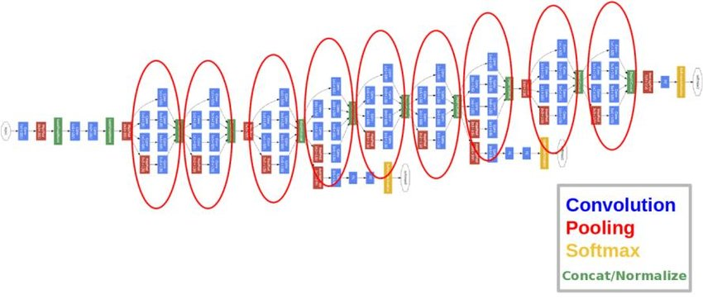
GOOGLENET

Slide 38
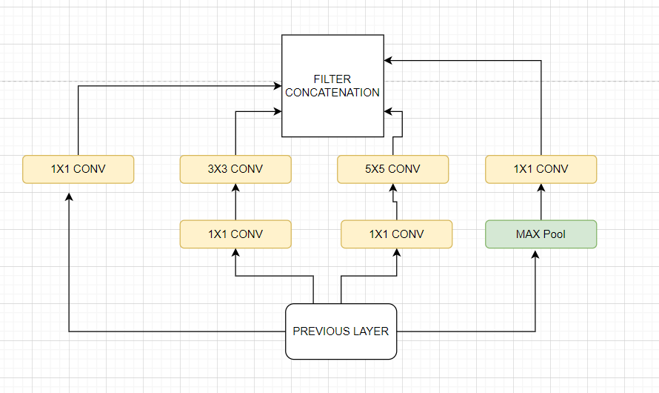
Google Net
GoogleNet has 22 layers, uses 1x1 Conv also global average pooling
In google net, there is inception module (have you seen that movie)
Same input goes to 1x1, 3x3 and 5x5

Slide 39
ResNet (152 Layers, No I will not draw it)
They managed to optimize it, desigining what to change in the input instead of what the output should be.
In Resnet, they added the input again after the calculations of conv layers. (residual blocks)
More info:
https://developer.ridgerun.com/wiki/index.php?title=GstInference/Supported_architectures/ResNet

Slide 40
Final words
You might have a cool red diploma or fancy job experience in some IT company but, when its about ML, you will not be able to fully conclude your work by just implementing your model.
Let me explain: You are human and you are not able to think outside the box ( your limitation is related to your sub-consciousness)
An example: Humans do not expect a chicken to fall from sky therefore they take precautions ( but ML thinks so)
Or to defend the humanity from an alien attack, ML would choose to nuke all humanity to defend. ( no humans, nothing to defend= success)
No humans= No problems= No cry = No chaos = No worries
Consider human kind as the destructive part of the eco system.
They decided to use NN to hire people ( many companies still use it, your fancy diploma and CV goes to a DNN.
Another reason for you to hate HR ☺☺☺☺☺
In 2014, just because more men applied to a job, NN declines all female candidates. Then they stopped the project.

